Slide 1
Better place project
Bake Sale – April 2, 2014
CSD LC2

Slide 2
Autism Speaks
Is an autism advocacy organization in the United States that sponsors Autism research and conducts awareness and outreach activities aimed at families, governments and the public.

Slide 3
Autism awareness
Autism affects 1 in 88 children and costs a family $60,000 a year on average. It is also the fastest-growing serious developmental disability in the U.S but receives less than 5% of the research funding of many less prevalent childhood diseases. Speech Language Pathologists work directly with those who have Autism to help improve their communicative and overall social skills.

Slide 4
Who are we?
A learning community of Communication Sciences and Disorders majors looking to make a difference.

Slide 5
CSD LC 2

Slide 6
“One can make a difference, but together we can make change.”

Slide 7
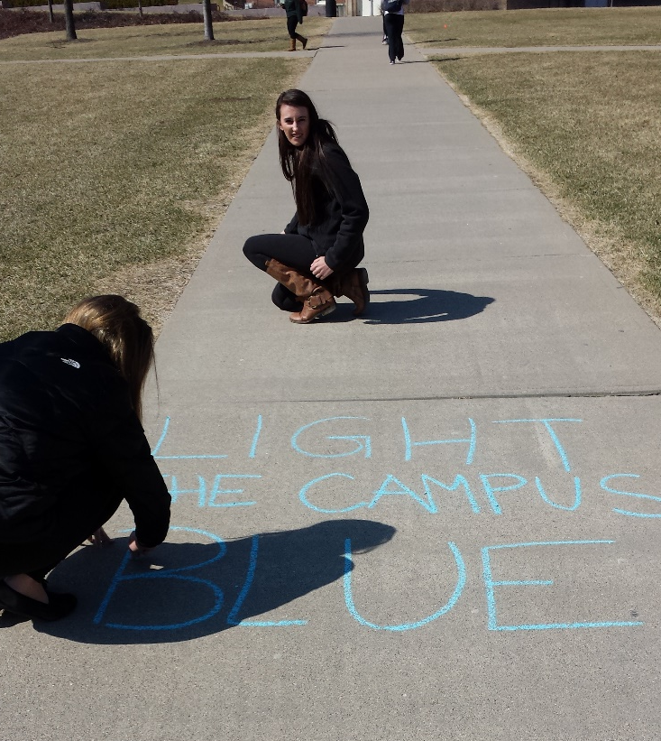
PLANNING AND PREPARATION
To make sure our bake sale was a success, we reached out to people through social media (special thanks to President Ono for the twitter shout-out), hung flyers around campus, and chalked McMicken Commons!

Slide 8
THE BIG DAY
What: Bake sale
Where: Campus Rec Center Breezeway
When: April 2, 2014 11am-2pm
Total amount raised: $185

Slide 9
“Once you’ve met one child with Autism, you’ve met one child with Autism.”

Slide 10
THANK YOU
LC members:
Abby Awad
Paige Gieske
Rachel Bailey
Madison Jasper
Katee Moon
Hannah Ratnasamy
Jessica Oesterday
Ty Burson
Onnie Middendorf
Jess Bohnenkamp
Abby Scherch
Jessica Rosselot
Paige Bracke
Margaret Lehmenkuhler
Nichole Martini
Peer Leader: Rachel DeLord

